Slide 1

Introduction to
Life
Insurance

Slide 2
Insurance is a sharing of economic loss
The Insurer in consideration of having received the premium from the Insured, undertakes to
make good the financial loss subject to limits of specified amounts, suffered by the Insured
as a result of a covered loss
Exposure to
Risks
Individuals
Transfer of Risk
Substitution of a certain small loss
called Premium for an uncertain large loss
Examples
Property(Home,Car) losses from fire
Personal losses from incapacity, death
Premium
Insurer’s
Pool
Benefits
(Loss Experienced)

Slide 3
Illustration of Concepts
Other financial products do not cover
risk of life
Consider a monthly deposit in a bank @ $100
And a monthly level premium of $100 towards life assurance for a sum assured of $20,000.
If death occurs after paying say 6 installments,
Bank will pay $ 600 + interest
Insurance company will pay $20000 + Bonus and other benefits (if eligible)
Other Advantages for Insurance
Premium is used for claiming tax relief
and the claim amount received in the end
is also not taxable
Temptation to drain the savings is low in
insurance policy
How does Insurance work?
500 men in a Town each aged 50
All having similar prospects of longevity
On an average 5 men die each year
Estimated economic Value of loss for family of each deceased member as $50,000
Each member contributes $500
The insurance works as follows :
Value of Common fund = 500 x 500 = $250,000
Amount payable on death to dependents =250000/5 = 50000
The risk of 5 persons is shared by 500
persons

Slide 4
Insurance relies on large numbers of individuals contributing to the pool
EXAMPLE
Insurance against death for one year
A single person
100 persons
500,000 persons
Insurance is having the losses of the unfortunate few paid by the contributions of the many who are exposed to the same risk.
Uncertainty
How many will
suffer losses?
Will he die during the year?
Only god knows.
How many will die during the year?
Only Speculation
How many will die during the year?
Observed death rates will vary from expected rates(from the population tables) by less than 1%
The Law of Large Numbers,applied to Insurance,holds that the greater the number of similar exposures to a risk, the less observed loss experience will deviate from expected loss experience.
Uncertainty of how many will suffer losses decreases as the number of exposure units increases.

Slide 5
Types of Insurance products
Insurance products differ with regards to the perils covered. A peril is a cause of loss.
Example: If the house burns because of fire, the peril or cause of loss is “fire”.
Private Insurance
Government Insurance
Social insurance – FICA, Workman’s Comp. compulsory disability
Unemployment Insurance
Other government insurance programs
Ex: crop insurance etc.
Life &
Health Insurance
Life Insurance
Annuities & Pension
disability and long-term care insurance
health insurance,accident insurance and medical expense insurance
Takaful or Islamic Insurance
Non-Life Insurance
(Property & Casualty Insurance)
Property losses-damage to or destruction of homes, autos, businesses, aircrafts
Liability losses-payments due to professional negligence, product defects etc.
Other forms of Non-Life Insurance
Marine Losses-damage to ships, & cargo
Engineering Losses-destruction to industrial equipments
Agriculture Losses – damage to crops
Specialty Losses –unique risks such as Satellite risk, Oil rigs etc.

Slide 6
Types of Life and Health Insurance Products
Life Insurance
(Coverage against death)
A life insurance policy that provides coverage for the whole of the person’s life is called Whole Life Insurance
A life insurance policy that covers insured for a time period,such as five or ten years, is called Term Life Insurance.
  A type of life insurance policy which pays the benefits if the person dies during the policy term or pays the benefits if the person survives the policy term is called Endowment Insurance.
Annuity
(Coverage against outliving the savings)
An Annuity is a contract that promises to pay the person, a periodic sum starting at a specified age, such as 65
  Immediate Annutiy, Contract pays a periodic sum regularly at specified intervals immediately after payment of the consideration
  Deferred Annuity: Contract pays a periodic sum regularly at specified intervals after a stipulated period called the deferred period
Health Insurance
(Coverage against incapacity or loss of good health)
A policy that provides protection against hospital, physician or other health care expenses is called medical expense insurance.
A policy that provides benefits if physical or mental incapacity prevents the person from being able to earn livelihood is called disability income insurance.
A policy that provides benefits if physical or mental incapacity prevents the person from executing activities of daily living is called long-term care insurance.

Slide 7
Life and Health Insurance pricing elements
1
The probability of
the insured event
Occurring
Likelihood of losses
Mortality tables show yearly probabilities of death
Morbidity tables show yearly probabilities on loss of good health
Age
Premium
Smoking-”Y”
Premium
2
Part of Premiums collected is invested to produce earnings which can supplement future premiums.
Time
(Premium
paying
term)
The time value of money
Premium
3
The benefits promised
Types of coverage, Terms of coverage, Additional benefits, Conditional Benefits
Benefits
Premium
4
Loading to cover expenses,
taxes, profits and other
contingencies
+
=
Gross Rate
Net Rate

Slide 8
Few terms to understand
Face Amount:In a life insurance policy the amount stated as payable at the death of the insured or at maturity of the contract.
Rider: An attachment to a life or health insurance policy that either adds benefits or exclude certain losses
Examples:
  Waiver of Premium: It allows a policyholder who becomes disabled or seriously ill to not pay the premiums after their illness / disability
  Guaranteed Insurability Option:It guarantees the right to purchase additional insurance cover without producing any further medical proofs.
Premiums Consideration payable in an insurance contract to secure the stipulated benefits
Lapse: The termination of insurance policy because of non-payment of premiums.
Cash Value of Life Insurance : The "savings" element of whole life (and universal) life insurance policies. The cash value is the amount of money accrued in the policy.
Illustrations of Life Insurance Policies :The printed projections of a life insurance policy's performance based on certain return and premium payment assumptions. Life insurance illustrations show both guaranteed and non-guaranteed values of a life insurance policy assuming no change over time in premium payments, death benefits, etc.
Dividend/Bonus: if the actual experience(pricing elements:mortality rates, lapse rates, expenses) for an insurer is better that the assumed experience used in pricing the policy, the insurance company will accumulate surplus. This distributable surplus is paid to the policyowners as dividends / bonus..These types of policies are called Non Guaranteed cost-Participating policies.
Guaranteed cost-non participating policies:All the policy elements are fixed. (Premiums, Face Amount, Cash Values etc.) The insurance company does not share surplus with the policyowners.

Slide 9
Types of Life Insurance Policies
  Term Insurance
  Pure Endowment
  Whole life
  Universal Insurance
  Group Insurance
  Annuity

Slide 10
Term Life Insurance
Term Life Insurance protects for a limited number of years(say 5 Years, 10 years) at the end of which the policy terminates with no maturity(cash) value. Benefits are payable only on death within the term
Note :Premium is comparatively less as there is no savings portion
Increasing Premium
Level Face Amount
Level Premium
Types of
Term Life Insurance
Non-Level Face Amount
Term Life Insurance Features
Renewability: The feature that allows policyowner to continue the policy for a limited number of additional terms of protection after the original term expires.
Convertibility: The feature that allows policypwner to exchange term life policy for a cash value policy, without needing to furnish evidence of insurability.
Reentry: The feature that allows policypwner to pay lower premium than otherwise if he or she can demonstrate continuing evidence of insurability.
Premiums rates are less than other types of insurance products
Suitable for individuals with high insurance needs and low income
Can serve as a hedge, in cases ,where death can impact investment capital, repayment of loans, or loss of key person

Slide 11
Pure Endowment
Pure Endowment protects for a limited number of years(say 5 Years, 10 years). Pure Endowment is the exact opposite of Term Insurance. Under this product the benefits are payable only if the insured survives the term of the insurance contract. Only premium paid is refunded in the event of death of insured within the contract period
All other Insurance products are hybrids & combinations of pure endowment & term insurance
Pure Endowment Features
Renewability: The feature that allows policyowner to continue the policy for a limited number of additional terms of protection after the original term expires.
Return of Premiums: In case of death during the term, the insurer returns the amount of premium paid so far less costs incurred on the policy
For Example
Endowment Insurance=Term Life Insurance +Pure Endowment
The insurer makes two mutually exclusive promises:
To pay the face amount if the insured dies during the
endowment period
or
To pay the face (or some other) amount if the insured
survives the endowment period
Premium rates for Endowment policies are higher than Term life
policies

Slide 12
Whole Life Insurance(1/2)
Whole Life Insurance provides the face amount upon the insured’s death regardless of when does it occur (no fixed term).
Note: Most of the whole life policies are constructed assuming the insured will die at the age of 100.
So whole life policies can be looked as endowment at-age-100 policies.
Major Types of Whole Life Insurance Policies
Ordinary Life Insurance Policies are the policies for which premiums are payable for the whole of life.
They are also called Straight Life or Continuous Premium Whole Life.
Limited-Payment Whole Life: Premiums are payable only for the limited number of years(say to the age 65) after that policies become fully paid-up policies.
A Paid-up Policy is the policy for which no further payments of premiums are required but the policy remains in effect.
Examples:
20-Payment Whole Life( Premiums are payable for 20 years
Life-paid-up-at-65 whole life( Premiums are payable only till age 65)
Variable Life Policies
Or
Unit –linked life policies
is a type of whole life policy whose values may vary directly with the set of earmarked investments.
The part of premiums that an Insurance company receives from policyholders are invested in the financial market.
In Variable Life Policies, the investment is made in separate accounts as per policyowners’ preference and the face amount and the cash value of the policies depend upon the performance of these separate accounts.

Slide 13
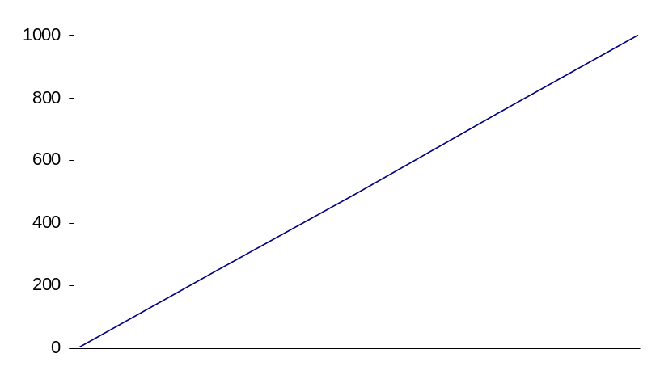
Whole Life Insurance(2/2)
Whole Life Cash Values
Whole life policies involve prefunding of mortality charges depending upon premium paying pattern and period. Because of that..
The insurance companies have to maintain Policy Reserves to meet obligations towards policyowners who have paid premiums. These reserves represent Insurance company’s liability towards Policyowners.
The policeowners who decide to terminate their policies are entitled to get partial refund of their premiums, which is called Cash Surrender Value.
Generally,
Cash Surrender Value
= Policy Reserve per policy-Surrender Charges
The difference between Policy Face Amount and
Policy Reserve per policy is called Net Amount At Risk
Net Amount At Risk
Face Amount
Policy Reserve
( Cash Surrender Value )
t

Slide 14
Universal Life Insurance
Universal life policies are flexible premium, adjustable death benefit unbundled life contract. All the pricing elements of insurance contract are transparent to customer.
Period 1 Cash
Value
Period 2 Cash
Value
Plus :
Plus :
Option A
A level Death Benefit
Cash Value
Net Amount at Risk
Option B
A level Net Amount at
Risk(NAR)
Cash Value
Death Benefit
Flexible Premium
Paid
Flexible Premium
Paid
Flexible Premium
Paid
Less :
Less :
Less :
Mortality Charges
Mortality Charges
Mortality Charges
Less :
Less :
Less :
Expenses Charges
Expenses Charges
Expenses Charges
Plus :
Plus :
Plus :
Investment Earnings
Investment Earnings
Investment Earnings
Equals :
Period 1 Cash
Value
Equals :
Period 2 Cash
Value
Equals :
Period 3 Cash
Value

Slide 15
Group Life Insurance
Insurance cover for a group of persons exposed to similar risk under a single contract of insurance. Predominantly
used by employers to provide protection to employees
Key Characteristics
Premium is computed for the whole group based on its nature
Policy remains in-force even after individual claims settlements.
The Insurance cover granted to each life is predefined - precludes individual choice
Minimum, but no maximum limit on the number of people covered
No medical examination; consideration of risk aspects of group is by proxy variables like industry type, worker category, health standards.
Low cost, flexible, simplified administration
Availability of Free cover / “No Evidence” Limits
Premium revised based on mortality experience

Slide 16
Annuity
An annuity is a series of periodic payment.
An annuity contract promises to make a series of payments for a fixed period or over a person’s (annuitant) lifetime
Classification of Annuities
Number of Life
Premium Payment Method
Time Payment Begins
Deposition of
Proceeds
Pure Life Annuity: Payments depend upon the existence of annuitant
Annuity Certain: Payments are certain and are payable for a period.
Immediate annuity:Payments are due immediately after an annuity is purchased with a single premium
Deferred Annuity:Payments are due after passage of term.
Single
Single
Multiple
Periodic
  -Fixed
  - Flexible
Immediate
Deferred
Annuity Certain
Pure Life Annuity
Annuity with
Refund
Face Amount
Cash Value
Annuity Payment
Accumulation Period
Liquidation Period

Slide 17
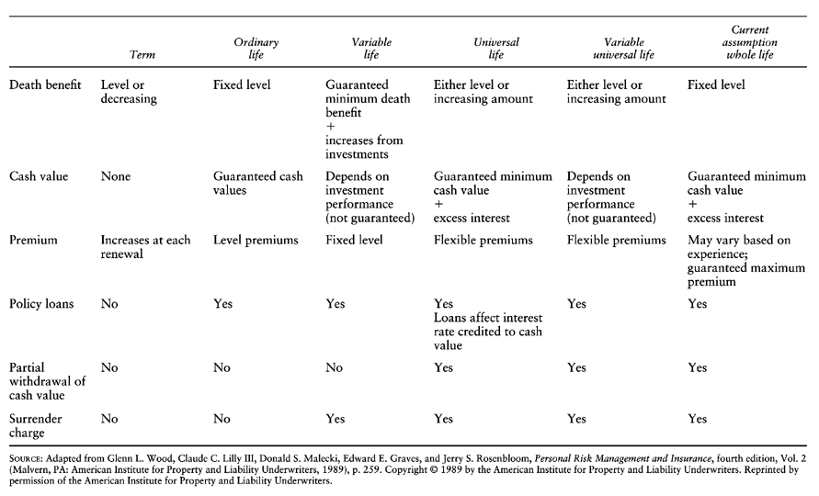
Comparison of various products

Slide 18
Key Life Insurance Riders
Endorsement includes changes to details affecting the terms and conditions of the policy
Reinstatement of policy
Mode or frequency of payment of premium.
Change of beneficiaries, assignee etc
Change of term, Sum assured, Benefits.
Rider is an amendment or addition to a contract that either expands or limits the benefits under the
contract.
Premium Waiver Benefit-Waiver of future premiums payable on the happening of a specified contingency.
Critical Illness benefit-Benefit payable when diagnosed with a specified illness.
Accident Benefit-Benefit payable on accidental death
Guaranteed Insurability Benefit-Right to purchase additional insurance of the same type on specified option dates without further medical proof.

Slide 19
Life Insurance Contract Terms(1/3)
Principles of an Insurance Contract
The parties to the insurance contract must be legally capable of making a contract
An agreement must be based on an offer made by one party (insurer) and an acceptance of that offer by the other party (policyowner) on the same terms
There must be a valuable consideration (premium) exchanged
The purpose of insurance contract must be lawful
Characteristics of Insurance Contracts
Utmost good faith: Each party is entitles to rely in good faith upon the representations of the other, and each is under an obligation not to attempt to deceive or withhold information from the other
Adhesion: The terms and provisions are fixed by one party (the insurer)
Values Policies: Life & Health policies are valued policies, meaning that insurer agrees to pay a stated sum irrespective of the actual economic loss
Unilateral: Only insurers make a legally enforceable promise
Aleatory: The contract involves the element of chance, and one party may receive more than the other
Conditional: Insurer’s obligation to pay benefits depends upon payment of premiums, and furnishing proof of loss

Slide 20
Life Insurance Contract Terms(2/3)-Key Players
Assignee
Absolute assignee has all the rights in the policy
Collateral Assignee has only some policy rights temporarily.
Assignment of rights
Beneficiary
The person to whom life insurance policy death benefits are paid on the death of the insured
The person named as the first to receive policy death proceeds is called the Primary beneficiary
Contingent beneficiary is the person who will receive death benefits if primary beneficiary is not alive at the insured’s death.
A revocable designation is a beneficiary designation that may be changed by the policyowner without the beneficiary’s consent.
In contrast,irrevocable designation is one that can be changed only with the beneficiary’s consent.
Policyowner
The person who owns the contract and can exercise all rights under the policy
Contract
Insurance
Company
Insurable Interest
Policyowner can expect to gain from insured’s continued life ,or, conversely, if he or she would suffer financial loss on the insured’s death.
Insurance interest in Ones’ own life
Family and marriage relationship
Creditor/Debtor relationship
Insured
The person whose life or health is the object of the insurance contract

Slide 21
Life Insurance Contract Terms(3/3)-Key Clauses
Reinstatement clause gives the policyowner the rights to reinstate a previously lapsed(because of non-payment of premiums) policy under certain conditions and within a time frame. The two most important conditions are furnishing of fresh evidence of insurability and paying past due premiums.
Policy loan clause gives the policyowner the rights to take loan against cash value accumulated under cash-value(whole life) life insurance policy
The Nonforfeiture provision provides the options under a cash-value policy if the policyowner elects to
terminate the policy. The non-forfeiture options available are:
  Cash (Cash Surrender Value)
  A reduced amount of paid-up insurance of the same kind as the original policy
  Extended term insurance for the full face amount
The Settlement options grant policyowners(and beneficiaries) options as to how death proceeds(face amount) will be paid. The settlement options available are:
  Cash( Face Amount)
  Interest option ( Face Amount is kept with the company and only interest is paid)
  Fixed-Period Option( Face Amount payable over a fixed duration)
  Fixed-Amount Option( Face amount payable in fixed-amount installment)
The Dividend options grant policyowners options as how to receive their share of distributable surplus. The dividend options available are:
  Cash
  Offset premium
  Purchase paid-up additional insurance
  Accumulate at interest
  One-year term insurance

Slide 22
Life Insurance company overview
Agent: A person who represents an insurance company to sell insurance products
Government
Regulation
Taxation
Underwriter: A person who determines whether and what terms to issue requested insurance.
Distribution
Agents
Brokers
Direct
response
Processing
Underwriting
Pricing
Application
processing
Claims handling
Policy owner
servicing
Financial
Management
Investment
Asset-liability
management
Customers
Individuals
Business
Financial
Market
Reinsurer: An Insurance company which assumes risks of another insurance company
Reinsurers
Other Players
Rating agencies
Actuary: A person who determines insurance premiums(the price of insurance products)

Slide 23
Life Insurance company organization and administration
Actuarial department establishes the insurer’s premium rates, reserve liabilities and generally handles all the mathematical operations of the insurer
Marketing department is responsible for the sale of new business.
Administration department is responsible for providing services to company’s internal and external customers
Policyowner Service provides customer service for the insurance contract from the time of issuance until termination
Claims Administration processes and pays claims against insurance policies
Underwriting department is responsible for establishing standards of selection and for passing judgments on applicants for Insurance
Accounting department is responsible for the establishing and controlling the insurer’s financial transactions
Legal department is charges with the responsibility of handling all the legal matters
Investment department handles the insurer's investment program
Human Resources enables the best possible use of people’s skills and talents
Information Systems manages and develops business critical computer information systems

Slide 24
Typical Policy Lifecycle
Not taken
Proposal
Declined
Cancel
Lapse
In force
Paid up
Reinstatement
Death
Maturity
Surrender
Payment &
Exit

Slide 25
Life Insurance company operations as per policy lifecycle
Customer
Service
Product
Development
& Actuarial Functions
Distribution
New Business
Claims Management
Policy
Servicing
Establish premium rates,
liability reserves,cash values(done by actuaries)
Design new policies & forms and get approval from regulatory authorities
Simplify existing products and add innovative features
Develop effective policy sales capability through agency and non-agency approach
Prepare and manage direct sales campaign
Distributor performance management
Agency commission mgt
Develop seamless interaction capabilities with distribution channels & customers
Process applications for insurance
Underwrite applications for insurance
Issue policies
Billing &
Collection
Claims case management across multiple channels
Gather information about the claim, the claimant, and the beneficiary
Investigate about the doubtful claims
Make claims and instruct to release death proceeds if necessary
Service customers across multiple channels
Administer policies from time of issuance until termination
Send premium notices and manage premium collection
Manage investment programs & accounting practices
Other Support Functions: Investment Management, Shared Services, Risk Management, Corporate Functions

Slide 26
Product Development
& Actuarial Functions
Key Processes
Evaluation & Preparation
Set clear vision of the new product development process
Analyze past experience of various products
Product Design
Establish premium rates, liability reserves,cash values
Design policies forms and get approval from regulatory authorities
Products Rollout
Make new products available to distribution channels
Train distribution channels about new products
Reserving & Valuation
Determine statutory reserves necessary to fulfill future contingencies and obligations arising out of insurance policies
Asset-Liability Management
Design strategy to earn an adequate return while maintaining a comfortable surplus of assets beyond liabilities.
To focus on clear customer needs
To design simple, competitive and legally approved products
To streamline product development processes
To establish seamless interfaces with external providers and regulatory authorities
Challenges
Product & Plan Management Solutions
Business Intelligence Solutions to analyze customer needs and past experience
Electronic interfaces with external providers and regulatory authorities using international standards
IT Systems

Slide 27
Distribution
Key Processes
Agency Management
Develop and maintain agency based sales management force. There are two types of approaches
  Branch Office System: The company manages agency braches at various location
  General Agency System: Company appointed General Agent builds the business for company
Recruit,train and manage qualification for sales force
Non-Agency Management
Develop and maintain alliances with brokers, banks, producer groups and financial intermediaries
Direct Sales
Prepare and manage direct sales campaign
Incentive Management
Develop and manage commission & bonus structures for distribution channels
To access and manage different routes to market
To build and to retain strong, mutually beneficial distribution relationships
To maintain product and service focus alongside operational flexibility
To Integrate and support of multiple distribution channels
Challenges
Agent’s Extranets
Incentive Management Systems
Sales force management systems
IT Systems

Slide 28
New Business(1/2)-Key Processes
New Business is one of the most important operational areas for a life insurance company
Ordering Additional Requirements / Synchronize Data
Customer Acquisition
Application Support
Submission & Verification Process
No
UW Ready?
Qualifications
Illustrations
Applications
Mail Handling
File Preparation
Policy Number Assignment
Compliance
License
Forms
Correspondence / Fax / Data Entry
Policy File / Policy Input
Yes
Incomplete Data on Application
Compliance / Requirements Data
Underwriting
Policy / Contract Issuance
Review
Risk Assessment
Quote or Decline
Final Verification
Updating Files
Notify Producer/Agent
Place In-Force
No
3rd Party Providers
Policy Ready ?
Request Additional Information
Yes

Slide 29
New Business(2/2)
Illustration Systems
Electronic Case Management System
Automated underwriting tools
Automated workflow
Electronic Document System
Imaging Solutions
Electronic Signature Capture
Agents’ Extranet
Electronic interfaces with customers, external providers and regulatory authorities using international standards(XML)
To streamline application processing which is very paper-intensive,time-consuming, error-prone and fragmented
To reduce hand-offs and issue a policy as fast as possible
To increase close ratios (applications turning into policies) while following all regulatory requirements
To establish seamless electronic interfaces with customers, agents and external providers of services
Develop automated capability to perform workflow, case management, risk assessment, underwriting, etc.
To enhance reinsurance capabilities
IT Systems
Challenges

Slide 30
Policy Servicing, Billing & Collection,
Customer Servicing, Investment Mgmt
To provide superior customer service across multiple channels while reducing operational costs
To follow all the mandatory regulatory compliances as well internal financial controls
Develop unified customer view across products and services
Challenges
Key Processes
Customer Servicing
To provide after sales-support for insurance products
To service customers across multiple channels
Policy Servicing
To cater to policyonwer’s requests for change in address, beneficiary, premium payment type and method etc.
To add or to remove a rider from the policy
To execute various functions like policy loan, lapse, dividend settlement etc. during the lifetime of a policy
Billing & Collection
To send premium notices, overdue premium notices etc.
To receive premium payments from various channels and update systems accordingly
Policy Administration system
Web Services based systems
Transactional portal
Voice/Data/Video convergence
IT Systems

Slide 31
Claims Management(1/2)
Policy Administration
Correspondence / Information on Existing Claim
Claim Analysis
Finalize Claim Decisions
Incoming
Requests
Case Setup
New Claim Notice
Make Claim Decision
Prepare Correspondence
Fax
Phone
Letters
Internet
Type of Request
Establish Case
Review / Update Requirements
Assign Analyst
Review Claim Information
Initiate/Review Referrals
Order Requirements
Yes
Claim Approved?
Inquiries
Yes
Expert Advice Needed?
Yes
Support Processes
3rd Party Processes (Medical, Legal, etc)
Payment Process
No
No
Review Case
Provide Information
Document Call
Review Claim Information
Order Requirements
Provide Guidance
Make Recommendations
Calculate Amount
Disburse Benefits
Update System
Expert Advice or Referrals
No

Slide 32
Claims Management(2/2)
Electronic Case Management System
Automated workflow
Electronic Document System
Imaging Solutions
Electronic Signature Capture
Transaction support portal
Electronic interfaces with customers, external providers and regulatory authorities using international standards(XML)
To optimize claims processing which is very paper-intensive and manual
To settle straight forward claims as fast as possible
To build scalable and robust system to handle large volume of claims
To establish seamless electronic interfaces with customers, agents and external providers of services
Develop automated capability to perform workflow, case management, and process payments
IT Systems
Challenges

